Slide 1

Global ai bootcamp: AI & Machine Learning
Bucharest December 15, 2018 #BucharestAIBootcamp #GlobalAIBootcamp

Slide 2


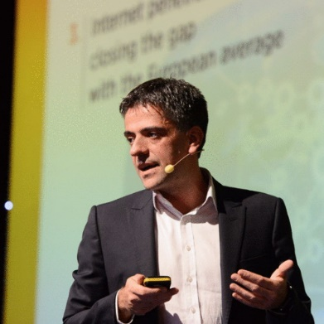
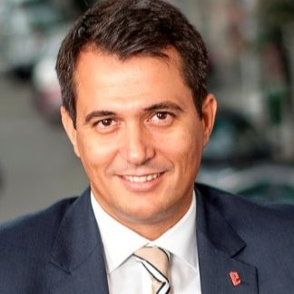





The Speakers #BucharestAIBootcamp #GlobalAIBootcamp
Sergiu Negut
Business Angel
Adrian Blidarus
Softelligence
Konstantinos Tovil TBI
Marian Ignat
BCR
Liviu Huluta Marsh
Octavian Cosenco
BCR Asigurari de Viata
Daniel Jinga Softelligence
Sorin Peste
Microsoft
Laurentiu Diaconu Softelligence

Slide 3
Agenda #BucharestAIBootcamp
10:00 - 10:20 | Opening Remarks
10:20 - 10:50 | Keynote: AI | Sergiu Negut Business Growth Consultant and Associated Dean with Maastricht School of Management
10:50 - 11:00 | Break
11:00 - 11:50 | AI: what you need to tell your CEO | Adrian Blidarus Founder and CEO, Softelligence
11:50 - 12:40 | Building the Business Case for A.I. in Financial Services | Konstantinos Tovil Senior Vice President E-Commerce, TBI Bank Marian Ignat Executive Director Digital Banking, BCR Liviu Huluta Head of Consumer & Commercial for Central, Southern and Eastern Europe, Marsh Octavian Cosenco Chief Risk Officer BCR Asigurari de Viata Panel discussion facilitated by Daniel Jinga Business Development Manager CEE, Softelligence
12:45 - 13:30 | Lunch
13:30 - 15:00 | Workshop #1: Using Custom Vision for Object Classification and Detection | Sorin Peste Technical Evangelist Data & AI, Microsoft
15:00 - 15:15 | Break
15:15 - 16:45 | Workshop #2: Fraudulent Claim Detection in Insurance Using Azure Machine Learning Studio | Laurentiu Diaconu Data Scientist, Softelligence
16:45 - 17:00 | Conclusions

Slide 4
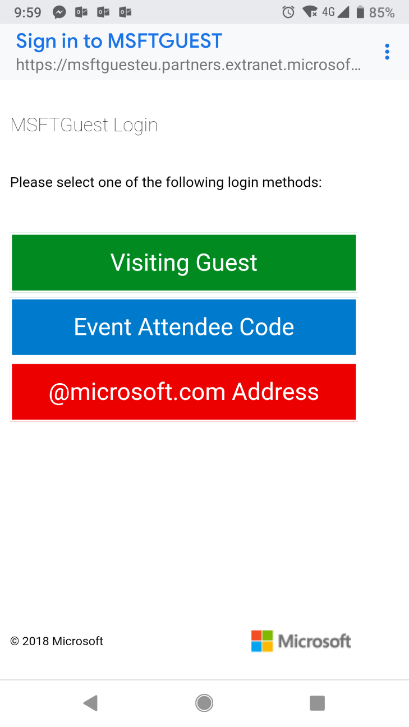
WiFi Access
Connection MSFTGUEST
Use Event Attendee Code msevent297fb
#BucharestAIBootcamp #GlobalAIBootcamp

Slide 5




Sponsors & Supporters
Organizer & Coffee Break Sponsor
Event Host
Lunch Break Sponsor
Raffle Sponsor
Winners announced at the end!
#BucharestAIBootcamp #GlobalAIBootcamp

Slide 6
Up Next Keynote: AI
Speaker: Sergiu Negut
Business Growth Consultant and Associated Dean with Maastricht School of Management
10:20-10:50
#BucharestAIBootcamp
#GlobalAIBootcamp

Slide 7
Coffee Break #BucharestAIBootcamp 10:50-11:00 ⇨ next session: AI: what you need to tell your CEO Adrian Blidarus WiFi MSFTGUEST use Event Attendee Code msevent297fb

Slide 8
Artificial Intelligence: what you need TO TELL YOUR CEO
Adrian Blidarus Founder & CEO, Softelligence
November 2018
#BucharestAIBootcamp
#GlobalAIBootcamp

Slide 9

What Is Artificial Intelligence And Why Does It Matter?
Artificial Intelligence is the theory and development of computer systems able to perform tasks normally requiring human intelligence, such as reasoning, adapting and learning.
Machine Learning is the study of algorithms and mathematical models that computer systems use to progressively improve their performance on a specific task.
#BucharestAIBootcamp #GlobalAIBootcamp

Slide 10
A Paradigm Change
From getting results
Input + Algorithm
= Output
To understanding the world and making connections
Input + Output
= Algorithm
#BucharestAIBootcamp #GlobalAIBootcamp

Slide 11
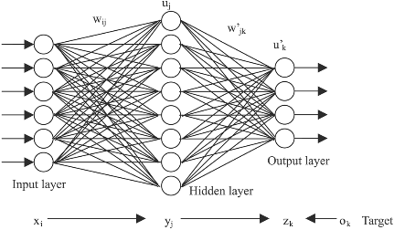
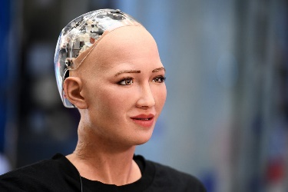
What Is Artificial Intelligence trying to achieve ?
Surpass humans
Simulate humans
Predictive modeling
Anomaly detection
Text
mining
Facial
recognition
Classification
Image
recognition
Natural Language
Processing
Sentiment recognition
Source: Clement Brunet, The Co-operators (presented at Insurance Nexus Analytics Summit 2018, Toronto, Canada)
#BucharestAIBootcamp #GlobalAIBootcamp

Slide 12


Managing difficulties
Areas where CEOs believe their role is more difficult that they were expecting.
Driving cultural change is the greatest difficulty in a CEO’s role.
50% | 48% | 47% | 40% | 35% | 31% | 25% | 23% | 20% | 18%
Driving cultural change | Finding time for myself for reflection | Developing my senior leadership team | Balancing short-term financials with longer-term company transformation | Managing the impact on my family/personal life | Maintaining my physical health | Engaing with external shareholders | Engaging with internal shareholders | Managing my stress levels | Connecting with my peers
Source: Egon Zehnder 2018

Slide 13

Three Myths About AI
Myth #1:
The main challenge is technology.
The main challenge is technology.
The main challenge is people.
AI in an enabler.
Business models are disruptive.
Myth #2:
AI is a disruptor.
AI is a disruptor.
Myth #3:
AI generates benefits.
AI generates benefits.
AI generates potential.
#BucharestAIBootcamp #GlobalAIBootcamp

Slide 14



Business Strategies for Delivering Innovation
Strategy 1 Go All-In
Take the leap of faith to create a spin-off company focused 100% on innovation.
Example: Aviva Digital Garage
Risk level: 
Strategy 2 Corporate Lab
Creating internal pockets of innovation within the larger company by putting in place a team dedicated to delivering pilot projects and Proofs of Concept.
Example: Beazley Labs
Risk level: 
Strategy 3 The Investor
Make small, targeted investments in other independent companies that deal with innovation rather than put your own company at risk.
Example: Alphabet Inc.
Risk level: 
#BucharestAIBootcamp #GlobalAIBootcamp

Slide 15


But what are the real-world business problems
we are trying to solve with AI?

Slide 16
Generic Use Cases for AI
Better customer experience
Reduce Expenses
Optimize Sales Efforts
Better risk management (through more accurate predictions)
Brand Differentiator
Improve Quality
Reduce Errors
#BucharestAIBootcamp #GlobalAIBootcamp

Slide 17

Intelligent Automation Applications in Insurance

Slide 18



Change Agents
Mobile
Artificial Intelligence
+255%
Year-on-Year increase in mobile claims (2018 vs. 2017)
Internet of Things
Source: CCC Industry Data Extrapolations
#BucharestAIBootcamp #GlobalAIBootcamp

Slide 19
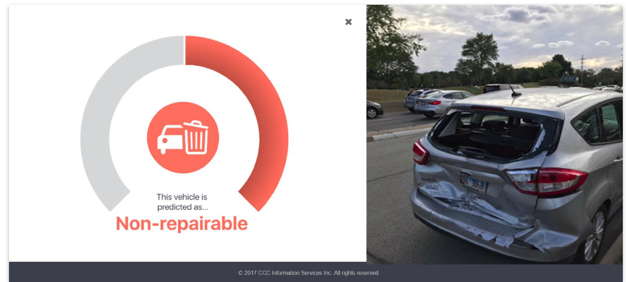
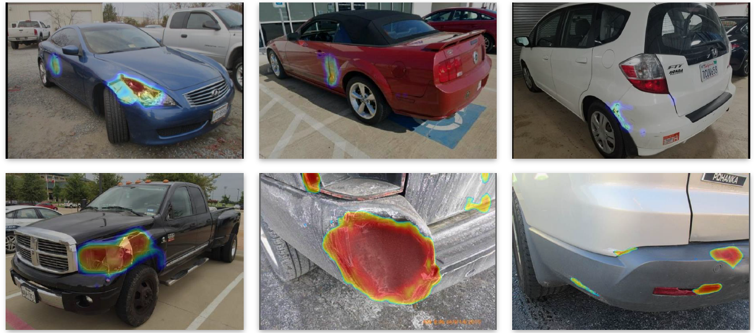
AI use cases in Insurance Claims
Chatbots
Virtual Inspection
Detection (Damage & Total Loss)
Auditing
Estimation
Insights
Damage Detection
#BucharestAIBootcamp #GlobalAIBootcamp

Slide 20
Example focus: leveraging data to deliver a seamless customer experience in a Home insurance policy purchase scenario
Goal: minimize the # of questions asked when buying home insurance from a Canadian insurance carrier
Benefits:
Improve customer experience
Increase sales/conversion %
Decrease purchase abandon %
Data sources:
Internal and External Data
Structured and Unstructured Data
# Questions
Few (<3)
Medium (<5)
High (5+)
~20%
~60%
~20%
#BucharestAIBootcamp #GlobalAIBootcamp

Slide 21


Leveraging Unstructured Data in Deep Learning on Images
Street View
Sattelite View
Type of output:
Number of stories
Type of garage
Chimneys
Construction year
Number of windows
Type of output:
Pool
Garden size
Trees in proximity
#BucharestAIBootcamp #GlobalAIBootcamp

Slide 22
So what do we do next?

Slide 23

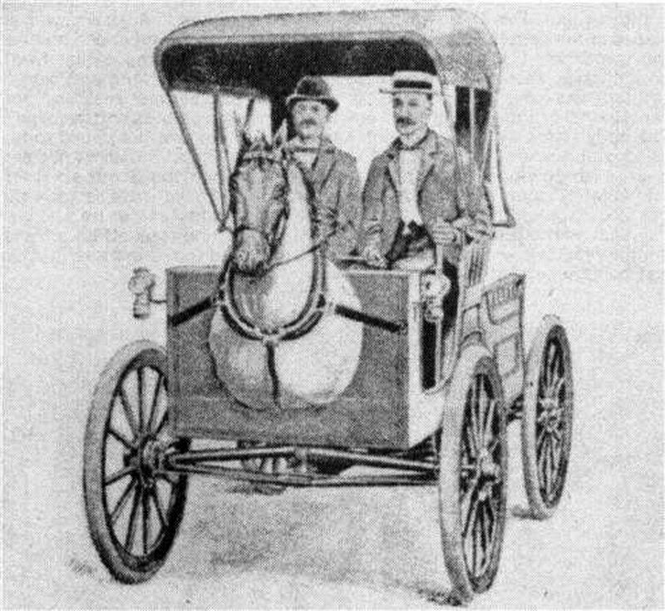
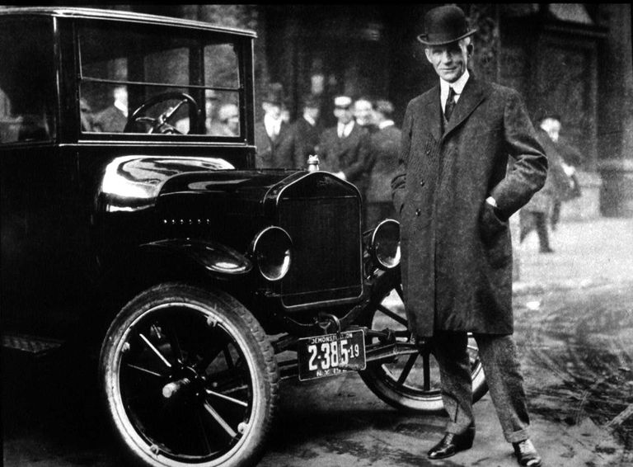
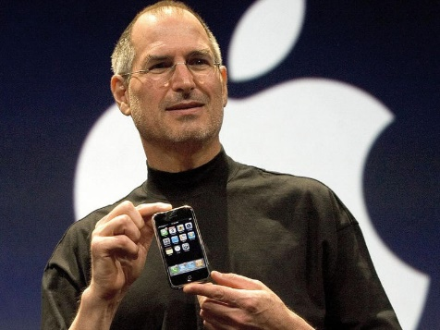
Making It Happen
Insight: by nature people ( e.g. CEO’s ) are reluctant to change. To overcome this, both a cross-functional cultural shift is needed as well as adopting a mindset of change and ongoing experimentation.
”
If I had asked people what they wanted, they would have said: faster horses.
– Henry Ford
”
It’s really hard to design products by focus groups. A lot of times, people don’t know what they want until you show them.
– Steve Jobs
#BucharestAIBootcamp #GlobalAIBootcamp

Slide 24
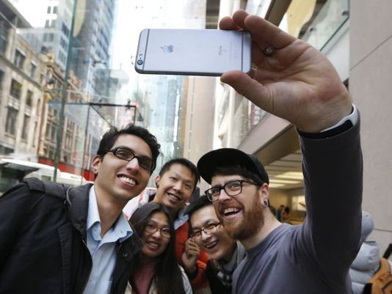





Step 1 Rethink
customer experience
Step 2 Redefine the role of the advisor
Step 3 Do a strategic workforce planning excercise
Step 4 Define what
success means
Step 5 Engage the business sponsor
Step 6 Experiment, measure and iterate
#BucharestAIBootcamp #GlobalAIBootcamp

Slide 25

Takeaways
AI works today. It relies on prototyping, iterations, learning and exercise.
AI is not a matter of technology or cost, but a matter of people, culture and mentality.
The real disruption is the business strategy.

Slide 26
“To survive and flourish in such a world, you will need a lot of mental flexibility and a great reserves of emotional balance.” Yuval Noah Harari
How fast can you change?

Slide 27
Questions?
Adrian Blidarus
Founder & CEO
Softelligence
learn more at softelligence.net

Slide 28





HAPPENING NOW Building the Business Case for A.I. in Financial Services
Panel discussion
11:50-12:40
Konstantinos Tovil Senior Vice President Digital Retail, TBI Bank
Marian Ignat Executive Director Digital Banking, BCR
Liviu Huluta Head of Consumer & Commercial for
Central, Southern and Eastern Europe, Marsh
Octavian Cosenco Chief Risk Officer BCR Asigurari de Viata
#BucharestAIBootcamp
#GlobalAIBootcamp
Facilitator: Daniel Jinga
Business Development Manager CEE, Softelligence

Slide 29
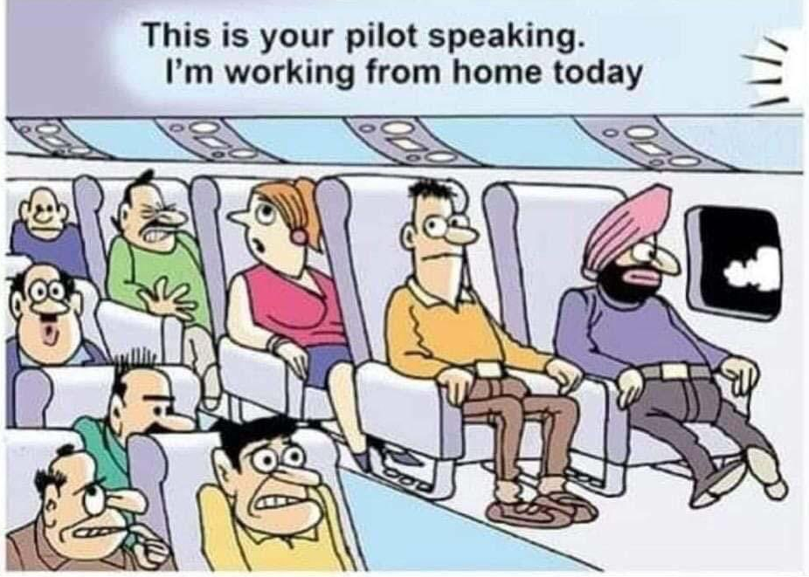
Panel Building the Business Case for A.I. in Financial Services
Panel discussion 11:50-12:40
Konstantinos Tovil Senior Vice President
Digital Retail, TBI Bank
Marian Ignat Executive Director Digital Banking, BCR
Liviu Huluta Head of Consumer & Commercial for
Central, Southern and Eastern Europe, Marsh
Facilitator: Daniel Jinga
Business Development Manager CEE, Softelligence
#BucharestAIBootcamp #GlobalAIBootcamp

Slide 30
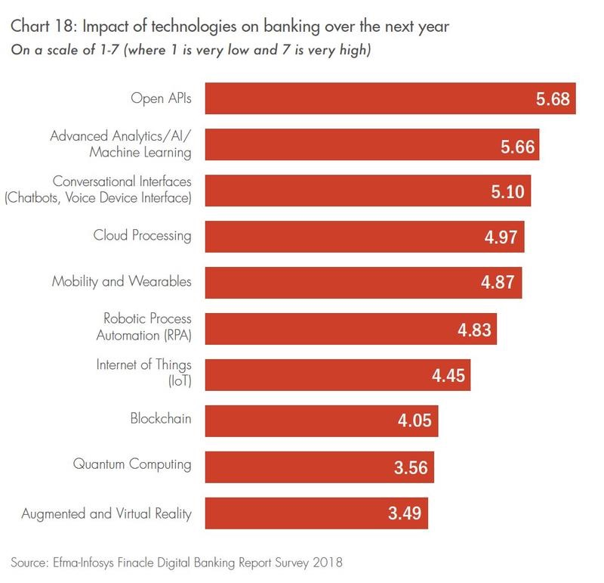
Panel Building the Business Case for A.I. in Financial Services
#BucharestAIBootcamp #GlobalAIBootcamp

Slide 31
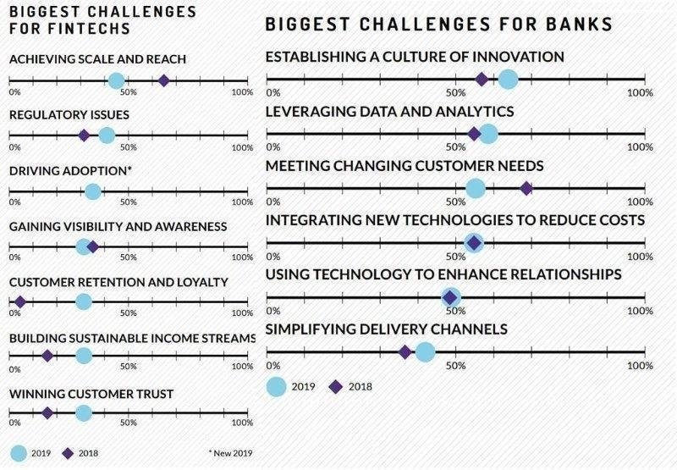
Panel Building the Business Case for A.I. in Financial Services
#BucharestAIBootcamp #GlobalAIBootcamp

Slide 32

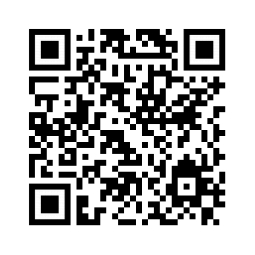
Lunch Break #BucharestAIBootcamp 12:45-13:30 ⇨ next workshop: Using Custom Vision for Object Classification and Detection Sorin Peste Check out the workshops on GitHub at bit.ly/BucharestAIBootcamp or scan the QR code WiFi MSFTGUEST use Event Attendee Code msevent297fb

Slide 33
Workshop #1 Using Custom Vision for Object Classification and Detection
Speaker: Sorin Peste
Technical Evangelist Data & AI, Microsoft
13:30-15:00
#BucharestAIBootcamp
#GlobalAIBootcamp
Important:
Your laptop is required in order to practice each step of the workshop.
Check out this workshop on GitHub at bit.ly/BucharestAIBootcamp.

Slide 34
Break #BucharestAIBootcamp 15:00-15:15 ⇨ next workshop Fraudulent Claim Detection in Insurance Using Azure Machine Learning Studio Laurentiu Diaconu Check out the workshops on GitHub at bit.ly/BucharestAIBootcamp or scan the QR code WiFi MSFTGUEST use Event Attendee Code msevent297fb

Slide 35
Workshop #2 Fraudulent Claim Detection in Insurance Using Azure Machine Learning Studio
Speaker: Laurentiu Diaconu
Data Scientist, Softelligence
15:15-16:45
#BucharestAIBootcamp
#GlobalAIBootcamp
Important:
Your laptop is required in order to practice each step of the workshop.
Check out this workshop on GitHub at bit.ly/BucharestAIBootcamp.

Slide 36

That’s a wrap! #BucharestAIBootcamp #GlobalAIBootcamp Winners announced. Workshops available on GitHub at bit.ly/BucharestAIBootcamp Thank you for your participation and please fill in the survey at bit.ly/AIBootcampSurvey
Sponsors

Slide 37

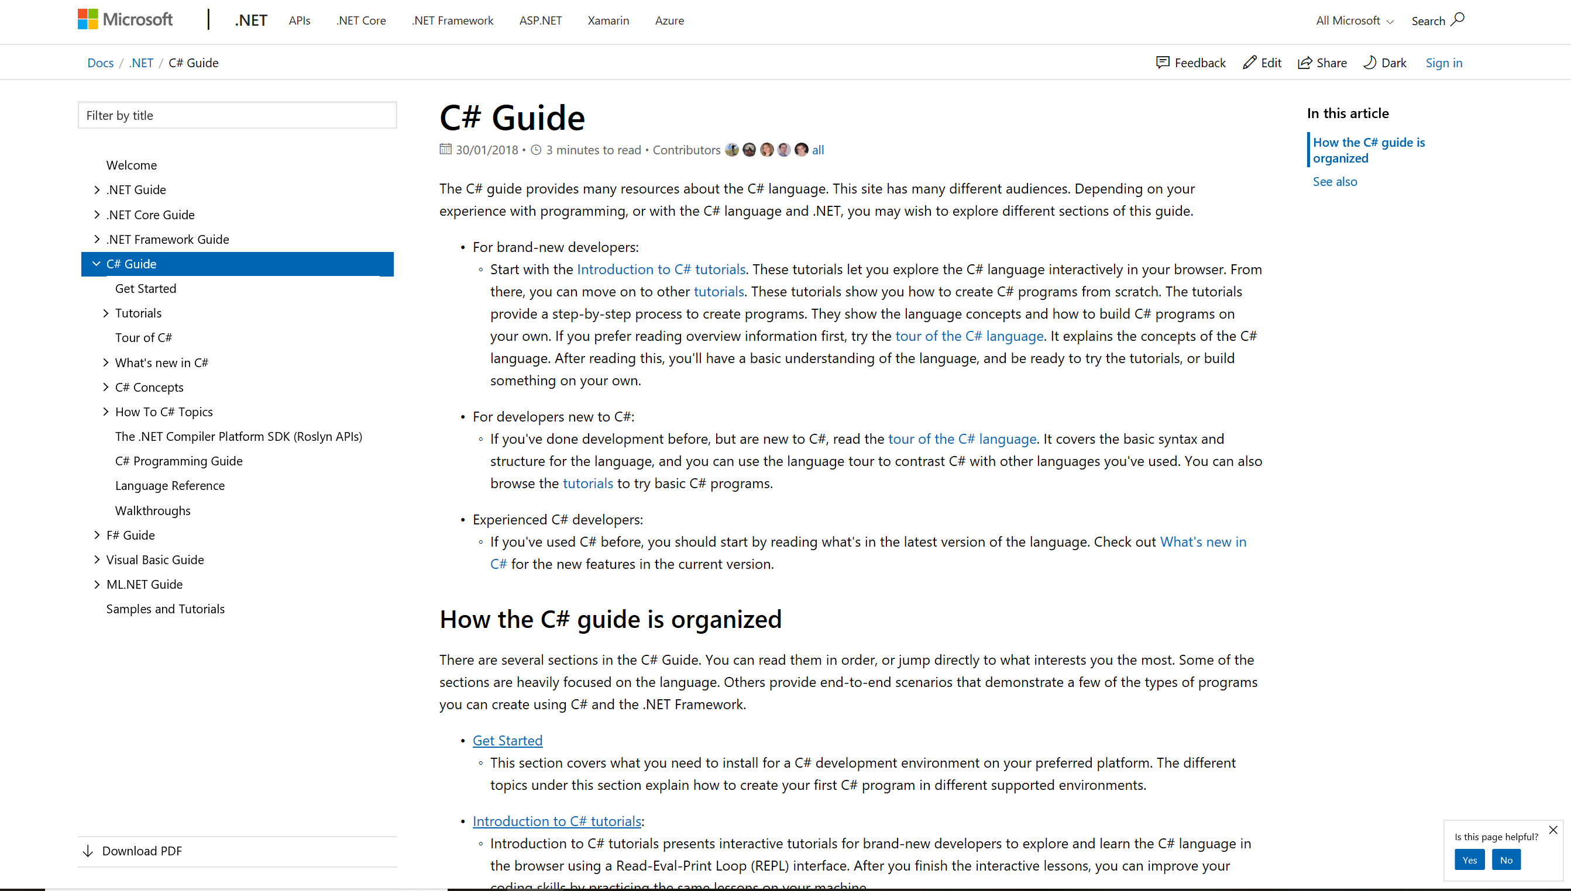
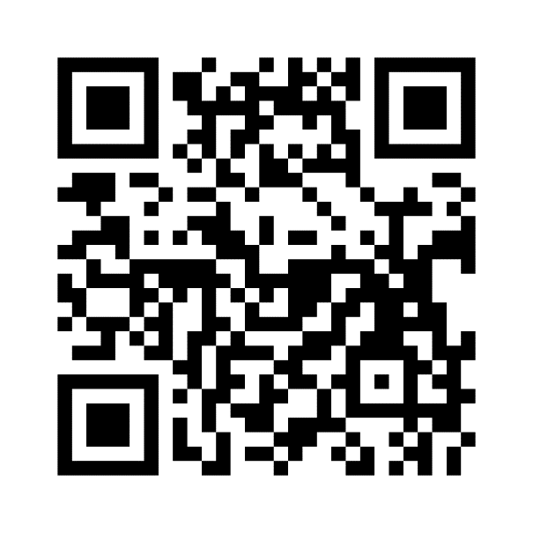
Docs.microsoft.com
One global service. The latest in technical documentation, training and solutions.
Scan the QR code below for
AI documentation and examples
Notes:
65 languages;
global by default
Foundation on Git
Replaces MSDN/TechNet Online

Slide 38
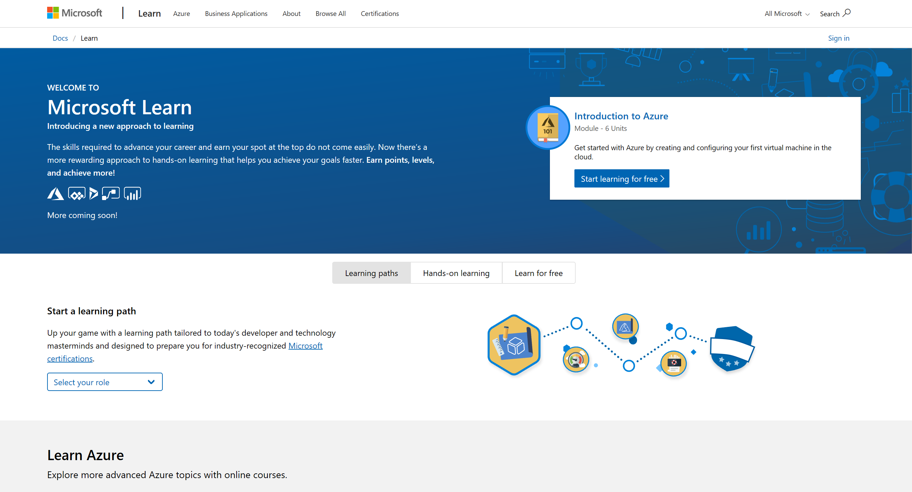
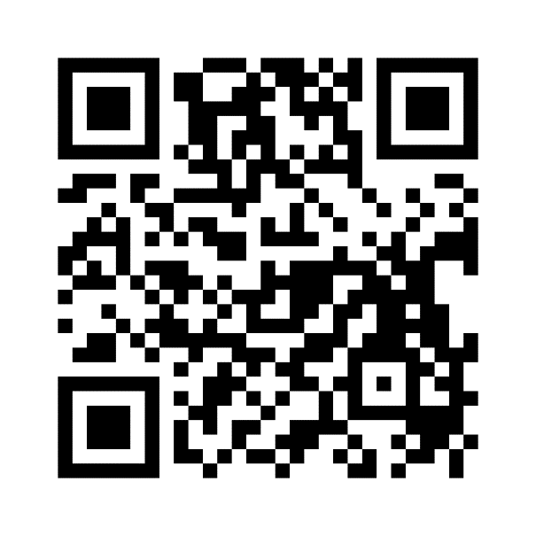
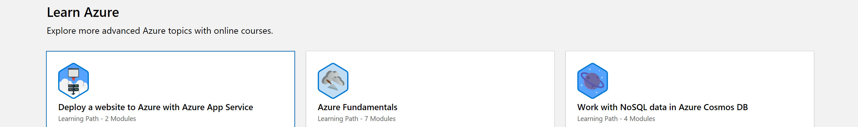
Microsoft Learn
Friction-free online learning. Have fun, unlock achievements, and get certified.
Scan the QR code below for
AI Microsoft Learn resources

Slide 39
ADVANCED ANALYTICS Introduction
Adrian Blidăruş
Softelligence Co-Founder & Managing Partner

Slide 40
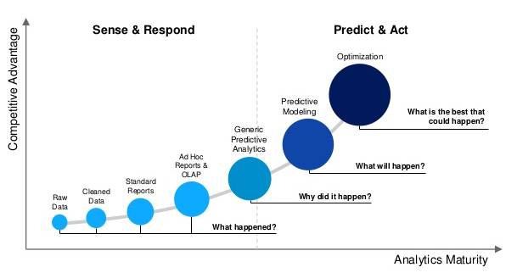
Advanced Analytics

Slide 41
Simplified types of questions Advanced Analytics can answer
Two class classification
Many class classification
Outlier analysis
Regression
Clustering
Is this A or B?
Is this A or B or C or D?
Is this Weird?
How much/How many?
What are the groups of similar objects?

Slide 42
Is this A or B?
This family is formally known as two-class classification.
It’s useful for any question that has just two possible answers: yes or no, on or off, smoking or non-smoking, purchased or not.
Lots of data science questions sound like this or can be re-phrased to fit this form. It’s the simplest and most commonly asked data science question
Typical questions
Will this customer renew their subscription?
Is this an image of a cat or a dog?
Will this customer click on the top link?
Will this tire fail in the next thousand miles?
Does the $5 coupon or the 25% off coupon result in more return customers?

Slide 43
Is this A or B or C or D?
This algorithm family is called multi-class classification.
Like its name implies, it answers a question that has several (or even many) possible answers: which flavor, which person, which part, which company, which candidate. Most multi-class classification algorithms are just extensions of two-class classification algorithms
Typical questions
Which animal is in this image?
Which aircraft is causing this radar signature?
What is the topic of this news article?
What is the mood of this tweet?
Who is the speaker in this recording?

Slide 44
Is this Weird?
This family of algorithms performs anomaly detection.
They identify data points that are not normal. If you are paying close attention, you notice that this looks like a binary classification question. It can be answered Yes or No. The difference is that binary classification assumes you have a collection of examples of both yes and no cases. Anomaly detection doesn’t.
This is particularly useful when what you are looking for occurs so rarely that you haven’t had a chance to collect many examples of it, like equipment failures. It’s also very helpful when there is a lot of variety in what constitutes “not normal,” as there is in credit card fraud detection
Typical questions
Is this pressure reading unusual?
Is this internet message typical?
Is this combination of purchases very different from what this customer has made in the past?
Are these voltages normal for this season and time of day?

Slide 45
How much/How many?
When you are looking for a number instead of a class or category, the algorithm family to use is regression.
Typical questions
What will the temperature be next Tuesday?
What will my fourth quarter sales in Portugal be?
How many kilowatts will be demanded from my wind farm 30 minutes from now?
How many new followers will I get next week?
Out of a thousand units, how many of this model of bearings will survive 10,000 hours of use?

Slide 46
Group Similar Objects
When we have a set of objects that have some characteristics and want to group them by the similarity of these characteristics in an unknown number of groups. There are several reasons of why you’d like to accomplish that:
There are statistical indicators (average, median, modus) that are not relevant for heterogeneous groups.
Elements from groups tend to have similar behavior
Sometimes before classifying you need to know the classes
Note: similarity needs to be defined and measure (in some cases this might prove challenging)
Typical questions
How can my customer can be grouped based on their behavior ?
How similar are the situations in which some events occur ?
How can I group my employees ?

Slide 47
Machine Learning
Supervised Learning
Classification
Regression
Unsupervised Learning
Clustering
Association Mining
Ranking
Segmentation
Dimension Reduction
Reinforcement Learning
Decision Process
Reward System
Recommendation Systems

Slide 48
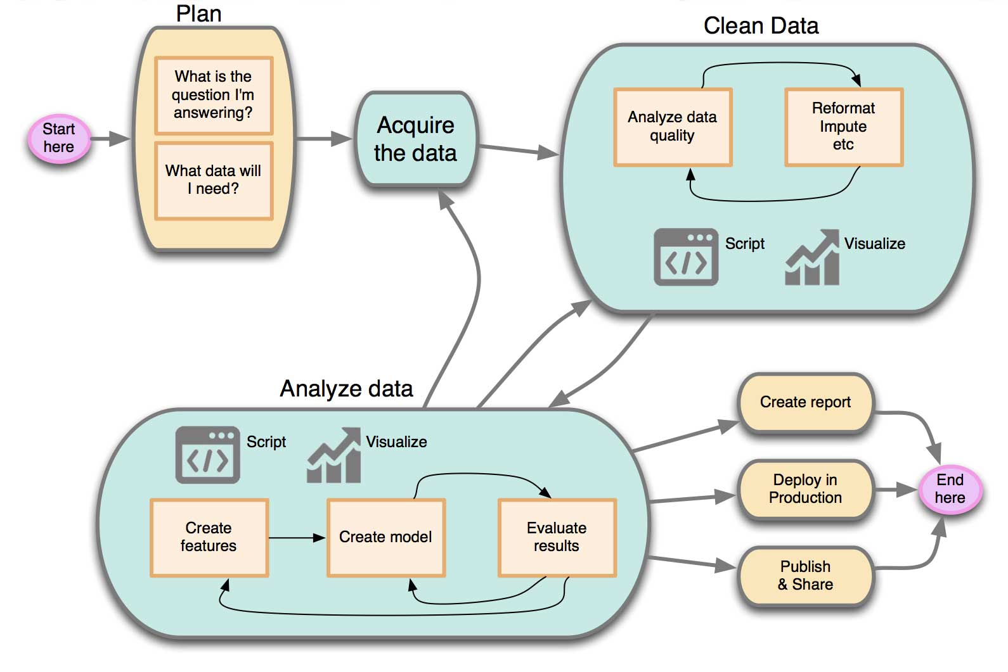
Modelling Process

Slide 49
Data science is a fancy way to say using numbers and names to answer a question
Brandon Rohrer, Senior Data Scientist at Microsoft

Slide 50
Questions
Your Question is Sharp
Your Data Measures What You Care About
Your Data is Accurate
Your Data is Connected
You Have a Lot of Data
Notes:
1. Your Question is Sharp
When choosing your data science question, imagine that you are approaching an oracle that can tell you anything in the universe, as long as the answer is a number or a name. But it’s a mischievous oracle, and its answer will be as vague and confusing as it can get away with. You want to pin it down with a question so airtight that the oracle can’t help but tell you what you want to know. Examples of poor questions are “What can my data tell me about my business?”, “What should I do?”, or “How can I increase my profits?” These leave a mile of wiggle room for useless answers. In contrast, clear answers to questions like “How many Model Q Gizmos will I sell in Montreal during the third quarter?” or “Which car in my fleet is going to fail first?” are impossible to avoid.
2. Your Data Measures What You Care About
Once you have a question it’s important to make sure your data is relevant. If you want to answer the question “Which of my customers is most likely to leave me for a competitor?”, you’ll need information about which customers have left for competitors in the past. On top of that, you’ll also need information on the factors that led to their leaving. If all you have is their birthdate and shoe size, you’re not likely to do a good job finding patterns in customers that left you. But if you have relevant data, like their purchase history and responses to customer satisfaction surveys, then you have a much better chance.
3. Your Data is Accurate
The biggest myth in data science is that you can make up for bad data by having a lot of it. In this imaginary world, it doesn’t matter if numbers are missing decimals, sensors fail, or names have been fat-fingered. Sheer volume of data mysteriously compensates. It is true that specialized tools like spell-checking can automatically correct for some errors. It is also true that unavoidable noise in otherwise carefully recorded data can sometimes be removed or worked around. But the type of errors introduced by sloppiness and neglect can’t be automatically fixed. They contaminate a data set and make it more difficult to find the patterns. Often, a small set of carefully collected data is more valuable to a data scientist than a very large set of carelessly collected data.
4. Your Data is Connected
Looking at the age of drivers in one state against the accident rate of drivers in another tells you nothing about how driver age and accident rate are related. For that, you need to look at the age and accident rates of the same group of drivers. Mountains of accurate, relevant data will do you no good if they aren’t describing the same data points. This is also known as the missing values problem. It’s the same as if your drivers provided you information by filling out a form, but half of them left the age field blank and the other half didn’t tell you about their accident history. Some missing values are normal and all but unavoidable. Too many missing values leaves your data collection looking like Swiss cheese and seriously degrades its usefulness.
5. You Have a Lot of Data
As in many things, data quality matters more than quantity. But quantity matters too. A small top-quality data set is more valuable than a very noisy behemoth. But a large high quality data set can do far more than either of them. More data is usually better, since it can let you see more details, ask more specific questions, and have greater confidence in the findings. Don’t assume that you have enough because there are already millions of data points or because you’ve already filled up a one terabyte hard drive. As long as it doesn’t degrade relevance, accuracy, or completeness, more data is always better.

Slide 51
Conclusions
Positioning
Do not position like technology savvy
Benefits
Create a long-term, trustful relationship
Business knowledge makes a lot of difference
Invest in Pilot projects
Have (hybrid) cloud in mind
Be ahead of the market
Have access to key people

